Slide 1

Illusory contours
Zhenyu Yang
Electrical and Computer Engineering
Source:http://www.cs.ucsb.edu/~cs181b/notes/3-elink.pdf

Slide 2
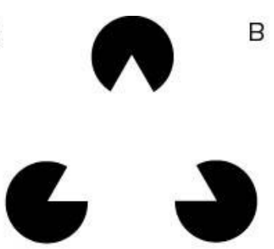
Illusory contours
Zhenyu Yang
Electrical and Computer Engineering
Source:http://www.cs.ucsb.edu/~cs181b/notes/3-elink.pdf

Slide 3
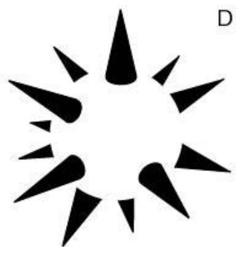
Illusory contours
Zhenyu Yang
Electrical and Computer Engineering
Source:http://www.cs.ucsb.edu/~cs181b/notes/3-elink.pdf

Slide 4

Illusory contours
Zhenyu Yang
Electrical and Computer Engineering
Source:http://www.cs.ucsb.edu/~cs181b/notes/3-elink.pdf

Slide 5
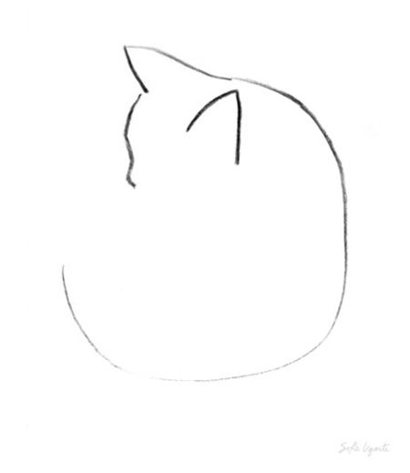
Illusory contours
Zhenyu Yang
Electrical and Computer Engineering
Source:https://www.pinterest.com/pin/554294666619782613/

Slide 6

Illusory contours
Zhenyu Yang
Electrical and Computer Engineering
Source: www.ilovedoodle.com

Slide 7
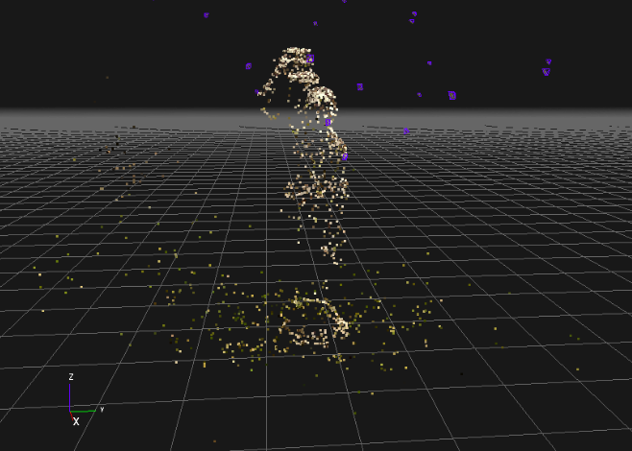
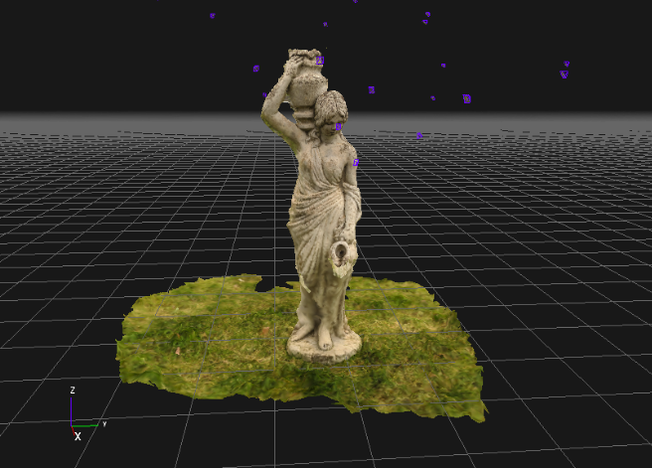
Sparse - Dense
Zhenyu Yang
Electrical and Computer Engineering

Slide 8
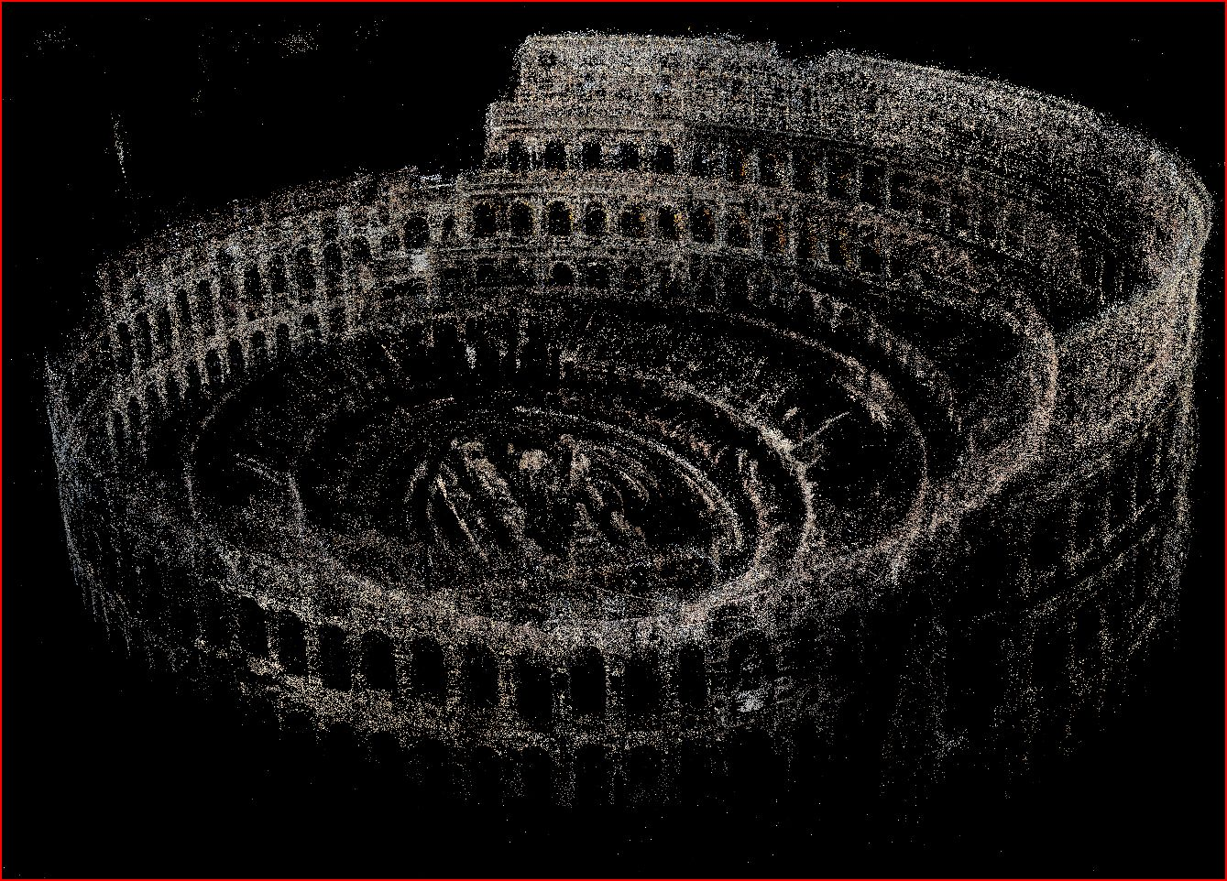
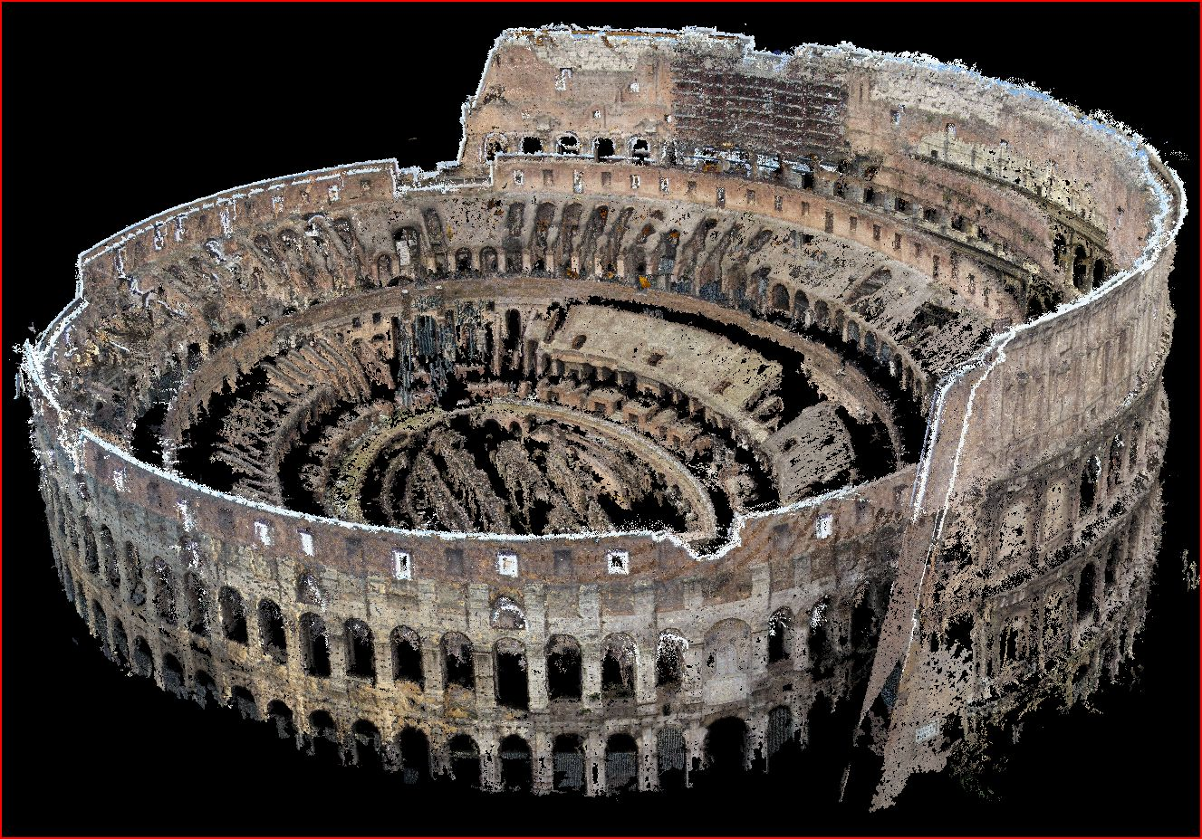
Sparse - Dense
Zhenyu Yang
Electrical and Computer Engineering

Slide 9
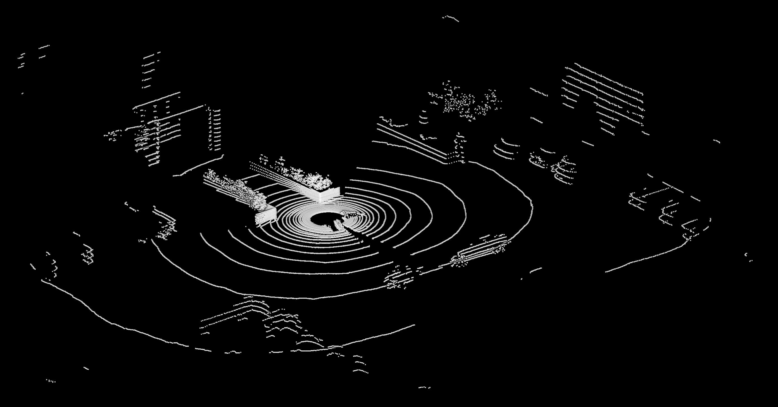
Sparse Point Cloud
Zhenyu Yang
Electrical and Computer Engineering

Slide 10
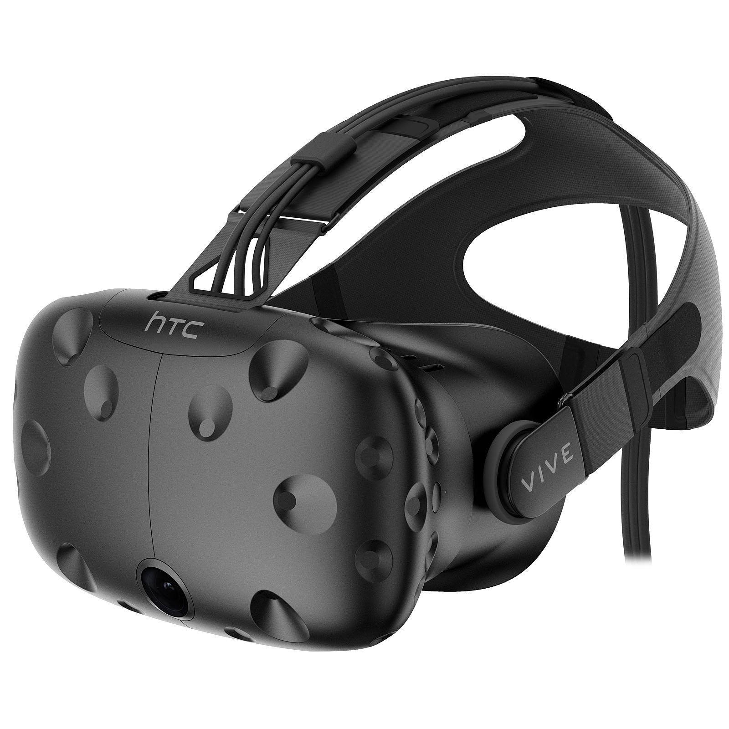
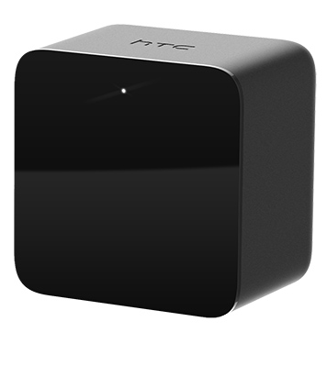
System
Sparse point cloud
Mono camera
LightHouse
Localization
Sparse 3D shapes in VR
Zhenyu Yang
Electrical and Computer Engineering

